Slide 1
CIEE Team Meeting
Linyi Xia 7/14/2014

Slide 2
Objectives
Identify critical path for creating a library of appliances load signature

Slide 3
Information needed for identifying device
Vrms
Irms
Power: Active and Reactive
Pf
Measurement resolution, 1ms after the device stabilized.

Slide 4
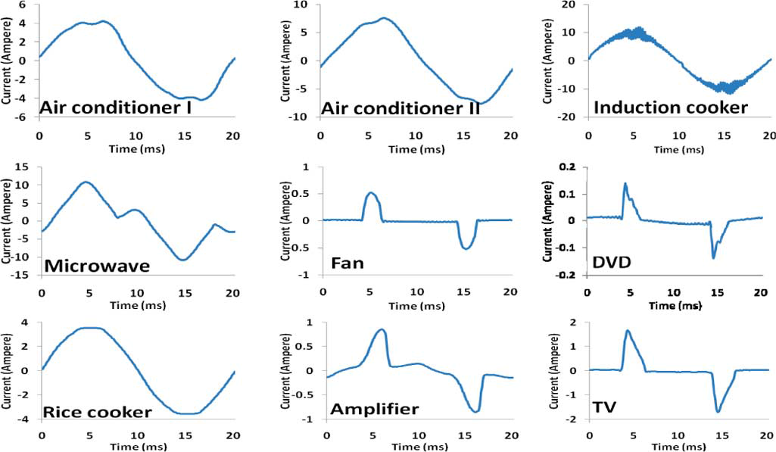
Examples from Papers
Micro Load Signature (20ms period)

Slide 5
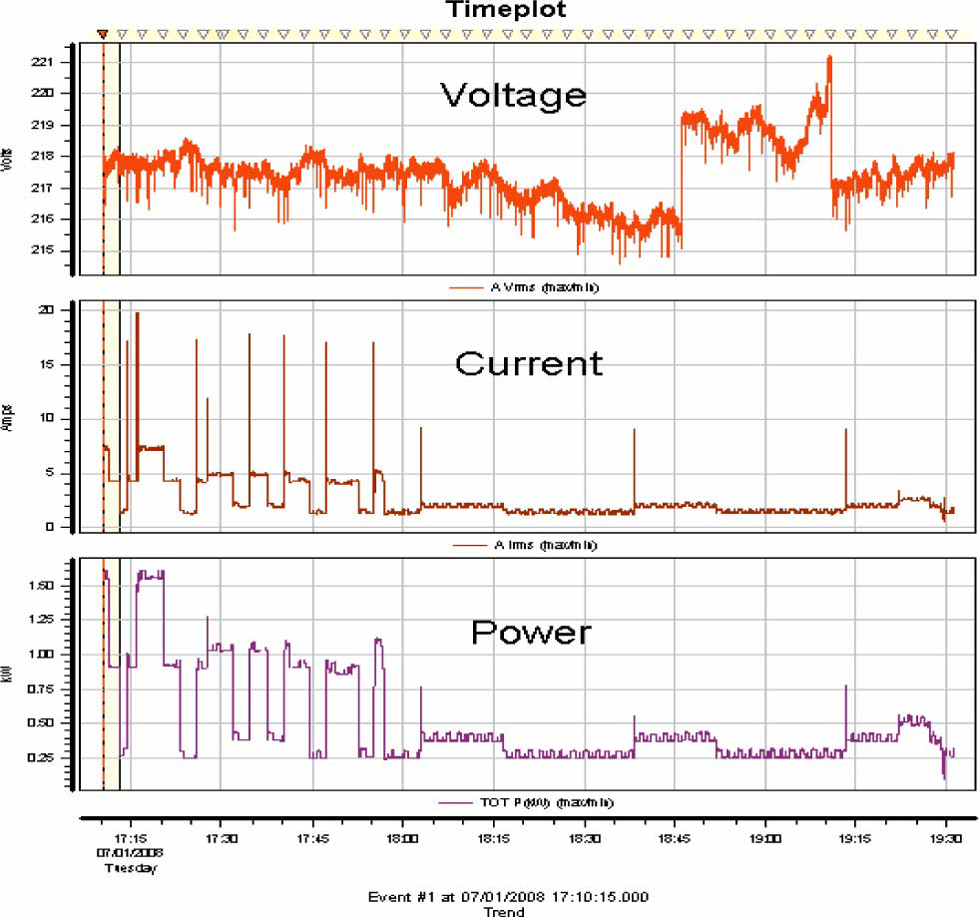
Examples from Papers
Macro-load signatures (over 2 hours shown)

Slide 6
Data Collected in CalPlug SimLab (TV)

Slide 7
Data Collected in CalPlug SimLab (TV)

Slide 8
Data Collected in CalPlug SimLab (TV)

Slide 9
Data Collected in CalPlug SimLab (TV)

Slide 10
Data Collected in CalPlug SimLab (TV)

Slide 11
Next Step(s)
Complete micro load signature
Data acquisition equipment purchasing
Acquire data
Device detection

